Slide 1

SENG2260 Human-Computer Interaction
Workshop 9
Week 9
SPS

Slide 2
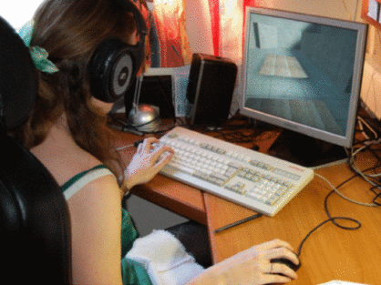
Today
RLT: Gamer bias in evaluation studies
You will have read:
S. P. Smith and S. Du'Mont. Measuring the effect of gaming experience on virtual environment navigation tasks, IEEE 3D User Interfaces 2009 (3DUI 09), pg 3-10, IEEE, 2009.
http://dx.doi.org/10.1109/3DUI.2009.4811198

Slide 3
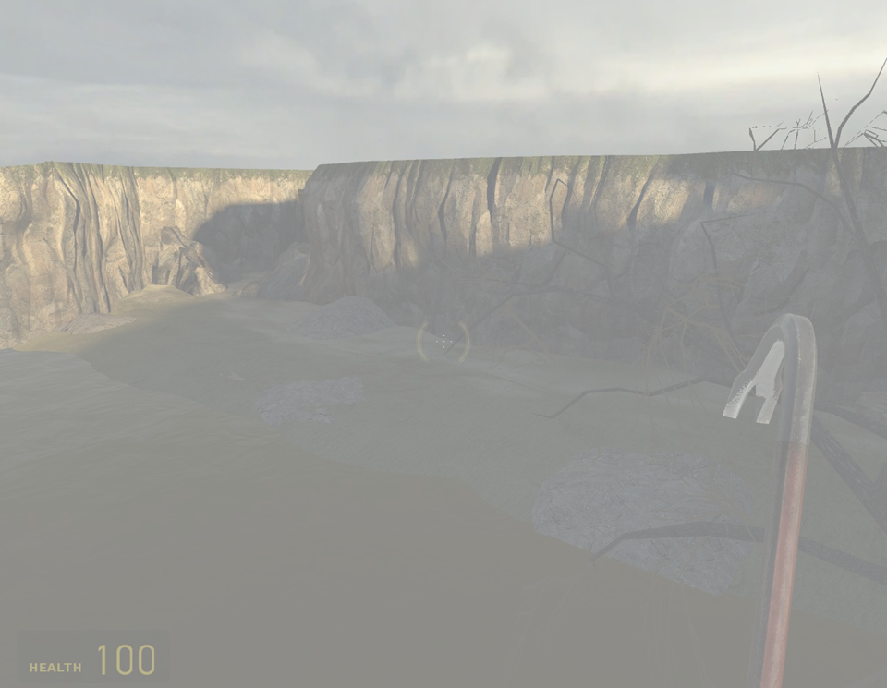
Computer Game Experience Bias in [Virtual Environment] User Evaluations
Virtual environments are increasingly being used in a wide variety of applications
Evaluation studies aim to identify usability problems or issues
Used to show fit-for-purpose
Participant’s previous experience with virtual environments and 3D user interfaces will effect their performance
Main exposure to 3D worlds (complex UIs)?

Slide 4
Impact of gaming experience
Use of training to diminish performance difference between gamers and non-gamers (Frey et al. 2007)
It did but gamers were still better
Game experience to support surgery (Enochsson et al. 2004)
Gamers were more efficient and completed tasks faster
Effects of action video games on visual searches (Castel et al. 2005)
Faster reaction times and more efficient searching displays
Improved performance in spatial tasks (Feng et al. 2007)
Benefits of action games (FPS) in improving performance in spatial tasks
Fire drill simulations (Smith and Trenholme 2009)

Slide 5
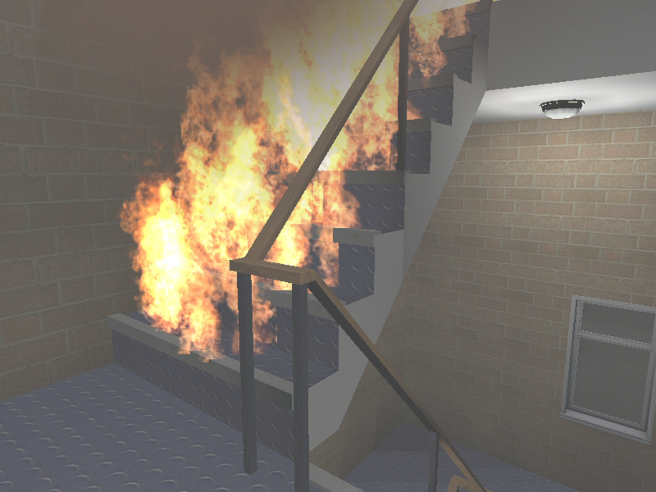
Impact of gaming experience
Use of training to diminish performance difference between gamers and non-gamers (Frey et al. 2007)
It did but gamers were still better
Game experience to support surgery (Enochsson et al. 2004)
Gamers were more efficient and completed tasks faster
Effects of action video games on visual searches (Castel et al. 2005)
Faster recation times and more efficient searching displays
Improved performance in spatial tasks (Feng et al. 2007)
Benefits of action games (FPS) in improving performance in spatial tasks
Fire drill simulations (Smith and Trenholme 2009)
Gamers were faster
But were they more reckless? – no penalty for death?
Perception of interaction as a “game” (Jennett et al. 2008)

Slide 6
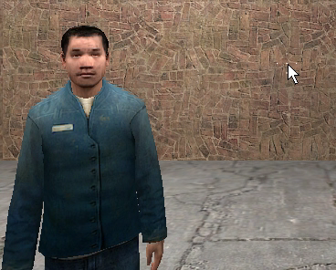
Big problem?
Problematic for virtual reality evaluations
Anecdotal evidence
Game technology reuse
Potential bias any results
Small samples
Participants and population
Problematic for general user interfaces?

Slide 7
In groups
Task 1 (15 minutes)
What is a gamer?
How might they bias your project evaluation?
How might you measure gaming impact?
How might you mitigate any gaming impact?

Slide 8
In groups
Task 2 (15 minutes)
What other classifications may bias user interface evaluations?
How might they bias your project evaluation?
How might you measure the impact?
How might you mitigate any such impact?

Slide 9
Other bias
Consider what other stakeholders might add bias an evaluation?
How might you minimise bias from these other stakeholders?

Slide 10
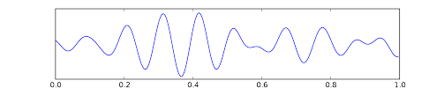
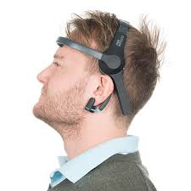
Next week
BCI: Brain Computer Interaction
Brainwaves. Not Thoughts

